Slide 1


Vandana W M
https://github.com/vandanawm
29/06/2022

Slide 2

Outline
Executive Summary
Introduction
Methodology
Results
Conclusion
Appendix

Slide 3
Executive Summary
Data was collected from public SpaceX API and SpaceX Wikipedia page. Created labels column ‘class’ which classifies successful landings. Explored data using SQL, visualization , folium maps , and dashboards. Gathered relevant columns to be used as features. Changed all categorical variables to binary using one hot encoding. Standardized data and used GridSeachCV to find the best parameters for machine learning models . Visualize accuracy score of all models.
Four machine learning models were generated :Logistic Regression, support vector machine, Decision tree classifier, and K-Nearest Neighbors . All the models produced similar results with 83.33% accuracy. All models over predicted successful landings. More data is needed to determine better model and accuracy.

Slide 4
Introduction
Background
Commercial Space Age is Here
SpaceX has best pricing ($62 million vs. $165 million USD)
Largely due to ability to recover part of rocket (Stage 1)
Space Y wants to compete with SpaceX
Problem
Space Y tasks us to train a machine learning model to predict successful stage 1 recovery

Slide 5

Section 1

Slide 6
Methodology
Executive Summary
Data collection methodology:
Combined data from SpaceX public API and SpaceX Wikipedia page
Perform data wrangling
Classifying true landings as successful else unsuccessful
Perform exploratory data analysis (EDA) using visualization and SQL
Perform interactive visual analytics using Folium and Plotly Dash
Perform predictive analysis using classification models
Tuned models using GridSearchCV

Slide 7
Data Collection
Data collection process involved a combination of API requests from Space X public API and web scraping data from a table in Space X’s Wikipedia entry.
The next slide will show the flowchart of data collection from API and the one after will show the flowchart of data collection from webscraping.
Space X API Data Columns:
FlightNumber, Date, BoosterVersion, PayloadMass, Orbit, LaunchSite, Outcome, Flights, GridFins,
Reused, Legs, LandingPad, Block, ReusedCount, Serial, Longitude, Latitude
Wikipedia Webscrape Data Columns:
Flight No., Launch site, Payload, PayloadMass, Orbit, Customer, Launch outcome, Version Booster, Booster landing, Date, Time

Slide 8
Data Collection – SpaceX API
Github URL:
https://github.com/vandanawm/IBM-Data-Science-Professional-certification/blob/main/Week%201%20Introduction/Data%20Collection%20Api%20.ipynb
Request(SpaceX APIs)
Filter data to only include Falcon 9 launches)
Imputate missing PayloadMass values with mean
JSON file+Lists(Launch Site, Booster Version,Payload Data)
Cast dictionary to a DataFrame
Json_normalize to DataFrame data from JSON
Dictionary relevant data

Slide 9
Data Collection - Scraping
Github URL:
https://github.com/vandanawm/IBM-Data-Science-Professional-certification/blob/main/Week%201%20Introduction/Data%20Collection%20with%20Web%20Scraping.ipynb
Request Wikipedia html
Cast dictionary to DataFrame
BeautifulSoup html5lib Parser
Iterate through table cells to extract data to dictionary
Find launch Info html table
Create dictionary

Slide 10
Data Wrangling
Create a training label with landing outcomes where successful =1 & failure =0
Outcome a column has two components :’Mission Outcome’ ‘Landing Location’
New training label column ‘class’ with a value of 1 if ’Mission Outcome’ is True and 0 otherwise.
Value Mapping:True ASDS,True RTLS,& True Ocean-set to ->1
None None , False ASDS , None ASDS , False Ocean , False RTLS –set to ->0
Github url:
https://github.com/vandanawm/IBM-Data-Science-Professional-certification/blob/main/Week%201%20Introduction/Data%20wrangling%20.ipynb

Slide 11
EDA with Data Visualization
Exploratory Data Analysis performed on variables Flight Number, Payload Mass, Launch Site, Orbit , Class and Year.
Plots Used:
Flight Number vs Payload Mass , Flight Number vs Launch Site , Payload Mass vs Launch Site , Orbit vs Success Rate , Flight Number vs Orbit , Payload vs Orbit , and Success yearly Trend
Scatter plots, line charts , and bar plots were used to compare relationships between variables to decide if a relationship exists so that they could be used in the training the machine learning model.
Github url:
https://github.com/vandanawm/IBM-Data-Science-Professional-certification/blob/main/Week%202%20EDA/EDA%20with%20Visualization.ipynb

Slide 12
EDA with SQL
Loaded data set into IBM DB2 Database.
Queried using SQL Python integration.
Queries were made to get a better understanding of the dataset.
Queried information about launch site names , various payload sizes of customers and booster versions , mission outcomes ,and landing outcomes
Github url:
https://github.com/vandanawm/IBM-Data-Science-Professional-certification/blob/main/Week%202%20EDA/EDA%20with%20SQL.ipynb

Slide 13
Build an Interactive Map with Folium
Folium maps mark launch Sites, successful and unsuccessful landings , and a proximity example to key locations : Railway , Highway , Coast and City.
This allows us to understand why launch sites may be located where they are . Also visualizes successful landings relative to location.
Github url:
https://github.com/vandanawm/IBM-Data-Science-Professional-certification/blob/main/Week%203%20Interactive%20Visual%20Analytics%20and%20Dashboard/Interactive%20Visual%20Analytics%20with%20Folium.ipynb

Slide 14
Build a Dashboard with Plotly Dash
Dashboard includes a pie chart and a scatter plot.
Pie chart is selected to show distribution of successful landings across all launch sites and can be selected to show individual launch site success rates.
Scatter plot takes two inputs: All sites or individual site and payload mass on a slider between 0 and 10000 kg.
The pie chart is used to visualize launch site success rate.
The scatter plot helps us to see how success varies across launch sites, payload mass, and
booster version category.
Github URL:
https://github.com/vandanawm/IBM-Data-Science-Professional-certification/blob/main/Week%203%20Interactive%20Visual%20Analytics%20and%20Dashboard/spacex_dash_app.py

Slide 15
Predictive Analysis (Classification)
Summarize how you built, evaluated, improved, and found the best performing classification model
You need present your model development process using key phrases and flowchart
Add the GitHub URL of your completed predictive analysis lab, as an external reference and peer-review purpose

Slide 16
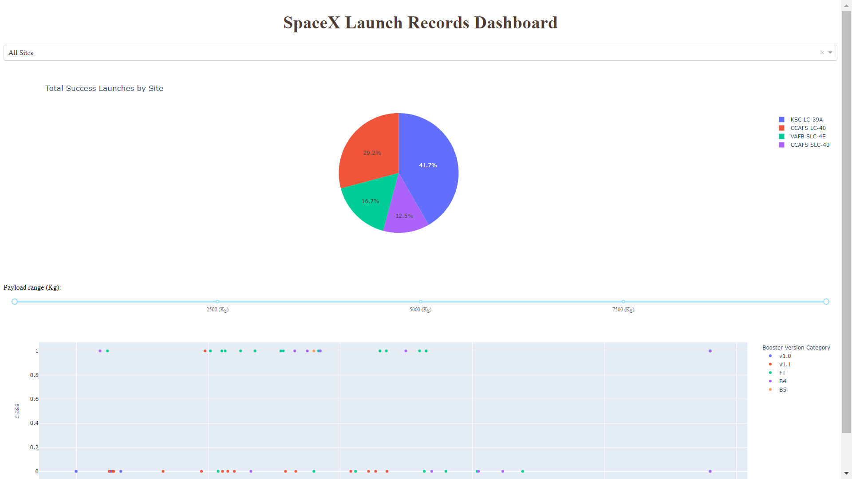
Results
The above shows the preview of Plotly dashboard . The following slides will show the results of EDA with visualization , EDA with SQL , Interactive Map with Folium, and finally the results of our model with about 83% accuracy.

Slide 17

Section 2

Slide 18
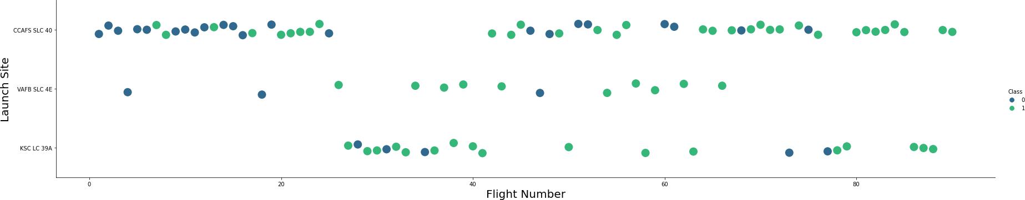
Flight Number vs. Launch Site
Green indicates successful launch ; Blue indicates unsuccessful launch.
The graphic shows an increase in success rate over time (indicated in Flight Number).
Likely a big breakthrough around flight 20 which significantly increased success rate.
CCAFS appears to be the main launch Site because it has the most volume.

Slide 19
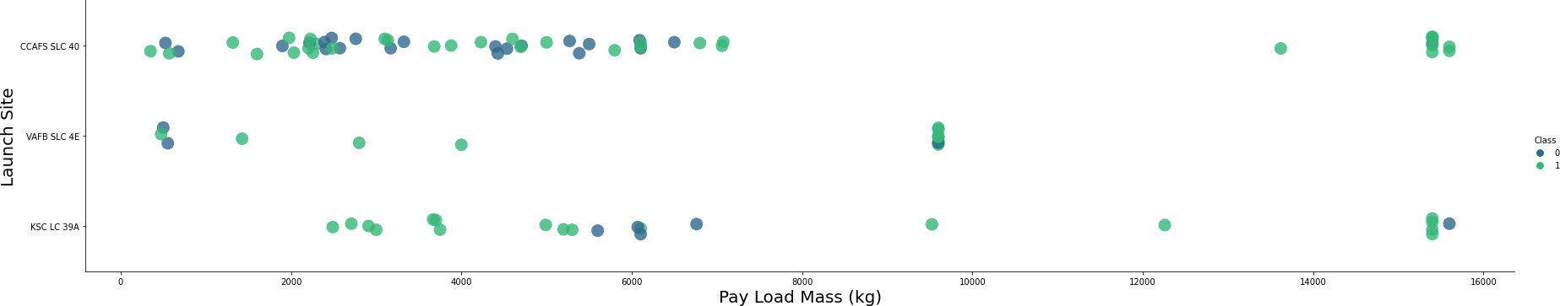
Payload vs. Launch Site
Green indicates successful launch ; Blue indicates unsuccessful launch.
Payload mass appears to fall mostly between 0 -6000kg.
Different launch sites also seem to use different payload mass.

Slide 20
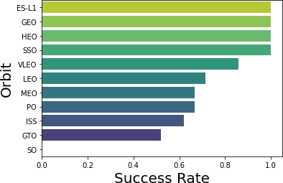
Success Rate vs. Orbit Type
ES-L1(1) , GEO(1),HEO(1) have 100% success rate (sample sizes in parenthesis )
SSO(S) has 100% success rate
VLEO(14) has decent success rate and attempts
SO(1) has 0% success rate
GTO(27) has around 50 % success rate but largest sample.

Slide 21
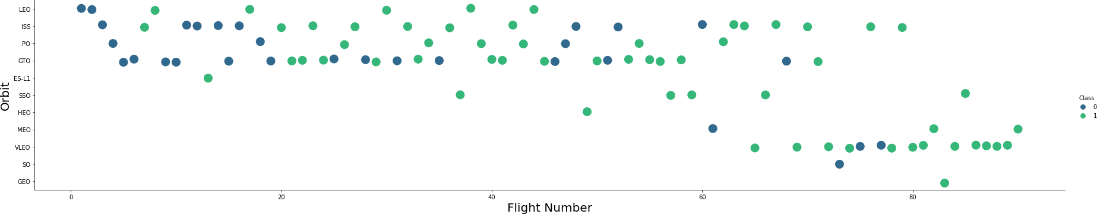
Flight Number vs. Orbit Type
Green indicates successful launch; Blue indicates unsuccessful launch.
Launch Orbit preferences changed over Flight Number.
Launch Outcome seems to correlate with this preference.
SpaceX started with LEO orbits which saw moderate success LEO and returned to VLEO in recent launches SpaceX appears to perform better in lower orbits or Sun-synchronous orbits

Slide 22
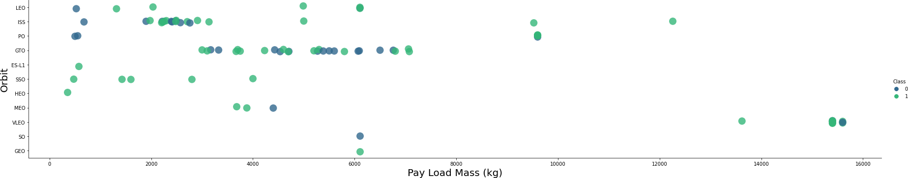
Payload vs. Orbit Type
Green indicates successful launch; Purple indicates unsuccessful launch.
Payload mass seems to correlate with orbit
LEO and SSO seem to have relatively low payload mass
The other most successful orbit VLEO only has payload mass values in the higher end of the range

Slide 23
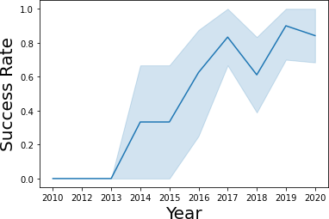
Launch Success Yearly Trend
95% confidence interval
(light lue shading)
Success generally increases over time since 2013 with a slight dip in 2018
Success in recent years at around 80%

Slide 24
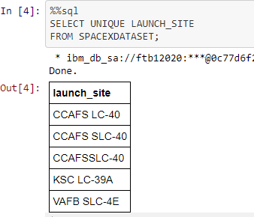
All Launch Site Names
Query unique launch site names from database.
CCAFS SLC-40 and CCAFSSLC-40 likely all represent the same
launch site with data entry errors.
CCAFS LC-40 was the previous name.
Likely only 3 unique launch_site values:
CCAFS SLC-40, KSC LC-39A, VAFB SLC-4E

Slide 25

Launch Site Names Begin with 'CCA'
First five entries in database with Launch Site name beginning with CCA.

Slide 26

Total Payload Mass
This query sums the total payload mass in kg where NASA was the customer.
CRS stands for Commercial Resupply Services which indicates that these payloads were sent to the International Space Station (ISS).

Slide 27
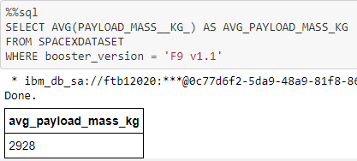
Average Payload Mass by F9 v1.1
This query calculates the average payload mass or launches which used booster version F9 v1.1
Average payload mass of F9 1.1 is on the low end of our payload mass range

Slide 28

First Successful Ground Landing Date
This query returns the first successful ground pad landing date.
First ground pad landing wasn’t until the end of 2015.
Successful landings in general appear starting 2014.

Slide 29

Successful Drone Ship Landing with Payload between 4000 and 6000
This query returns the four booster versions that had successful drone ship landings and a payload mass between 4000 and 6000 non inclusively.

Slide 30
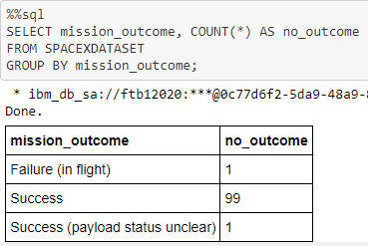
Total Number of Successful and Failure Mission Outcomes
This query returns a count of each mission outcome.
SpaceX appears to achieve its mission outcome nearly 99% of the time. This means that most of the landing failures are intended.
Interestingly, one launch has an unclear payload status and unfortunately one failed in flight.

Slide 31
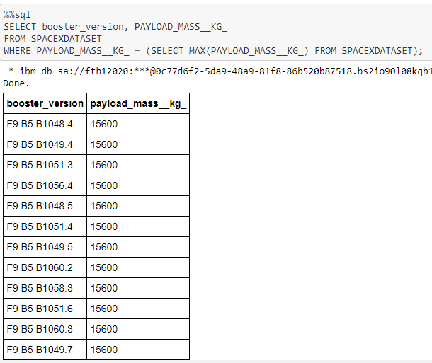
Boosters Carried Maximum Payload
This query returns the booster versions that carried the highest payload mass of 15600 kg.
These booster versions are very similar and all are of the F9 B5 B10xx.x variety.
This likely indicates payload mass correlates with the booster version that is used.

Slide 32
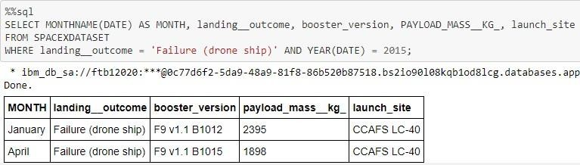
2015 Launch Records
This query returns the Month, Landing Outcome, Booster Version, Payload Mass (kg), and Launch site of 2015 launches where stage 1 failed to land on a drone ship.
There were two such occurrence

Slide 33
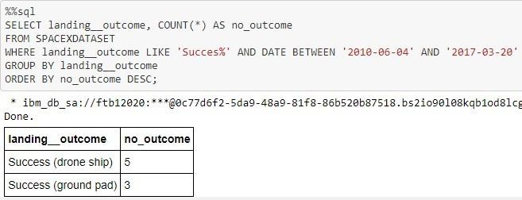
Rank Landing Outcomes Between 2010-06-04 and 2017-03-20
This query returns a list of successful landings between 2010-06-04 and 2017-03-20 inclusively.
There are two types of successful landing outcomes: drone ship and ground pad landings.
There were 8 successful landings in total during this time period

Slide 34

Section 3

Slide 35

Launch Site Locations
The left map shows all launch sites relative US map. The right map shows the two Florida launch sites since they are very close to each other. All launch sites are near the ocean.

Slide 36

Color Coded Launch Markers
Clusters on Folium map can be clicked on to display each successful landing (green icon) and failed landing (red icon). In this example VAFB SLC-4E shows 4 successful landings and 6 failed landings

Slide 37



Key Location Proximities
Using KSC LC-39A as an example, launch sites are very close to railways for large part and supply transportation. Launch sites are close to highways for human and supply transport. Launch sites are also close to coasts and relatively far from cities so that launch failures can land in the sea to avoid rockets falling on densely populated areas.

Slide 38

Section 4

Slide 39
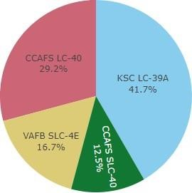
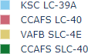
Successful Launches Across Launch Sites
This is the distribution of successful landings across all launch sites. CCAFS LC-40 is the old name of CCAFS SLC-40 so CCAFS and KSC have the same amount of successful landings, but a majority of the successful landings were performed before the name change. VAFB has the smallest share of successful landings. This may be due to smaller sample and increase in difficulty of launching in the west coast

Slide 40
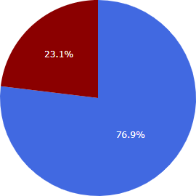
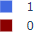
Highest Success Rate Launch Site
KSC LC-39A Success Rate(blue=success)
KSC LC-39A has the highest success rate with 10 successful landings and 3 failed landings.

Slide 41

Payload Mass vs Success vs Booster Version category
Plotly dashboard has a Payload range selector. However, this is set from 0-10000 instead of the max Payload of 15600. Class indicates 1 for successful landing and 0 for failure. Scatter plot also accounts for booster version category in color and number of launches in point size. In this particular range of 0-6000, interestingly there are two failed landings with payloads of zero kg.

Slide 42

Section 5

Slide 43
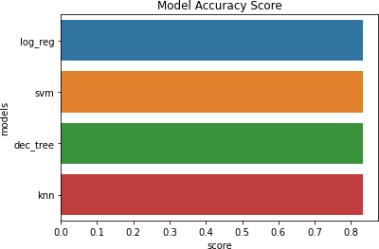
Classification Accuracy
All models had virtually the same accuracy on the test set at 83.33% accuracy. It should be noted that test size is small at only sample size of 18.
This can cause large variance in accuracy results, such as those in Decision Tree Classifier model in repeated runs.
We likely need more data to determine the best model.

Slide 44

Confusion Matrix
Correct
predictions are
on a diagonal
from top left
to bottom right.
Since all models performed the same for the test set, the confusion matrix is the same across all models. \
The models predicted 12 successful landings when the true label was successful landing.
The models predicted 3 unsuccessful landings when the true label was unsuccessful landing.
The models predicted 3 successful landings when the true label was unsuccessful landings (false positives).
Our models over predict successful landings.

Slide 45
Conclusions
Our task: to develop a machine learning model for Space Y who wants to bid against SpaceX
The goal of model is to predict when Stage 1 will successfully land to save ~$100 million USD
Used data from a public SpaceX API and web scraping SpaceX Wikipedia page
Created data labels and stored data into a DB2 SQL database
Created a dashboard for visualization
created a machine learning model that had an accuracy of 83%
Allon Mask of SpaceY can use this model to predict whether a launch will have a successful Stage 1 landing before launch with relatively high accuracy to determine whether the launch should be made or not
If possible more data should be collected to better determine the best machine learning model and improve accuracy

Slide 46
Appendix
GitHub repository url:
https://github.com/vandanawm/IBM-Data-Science-Professional-certification
Instructors:
Instructors: Rav Ahuja, Alex Aklson, Aije Egwaikhide, Svetlana Levitan, Romeo Kienzler, Polong Lin, Joseph Santarcangelo, Azim Hirjani, Hima Vasudevan, Saishruthi Swaminathan, Saeed Aghabozorgi, Yan Luo
Special Thanks to All Instructors:
https://www.coursera.org/professional-certificates/ibm-data-science?#instructors

Slide 47


